Slide 1
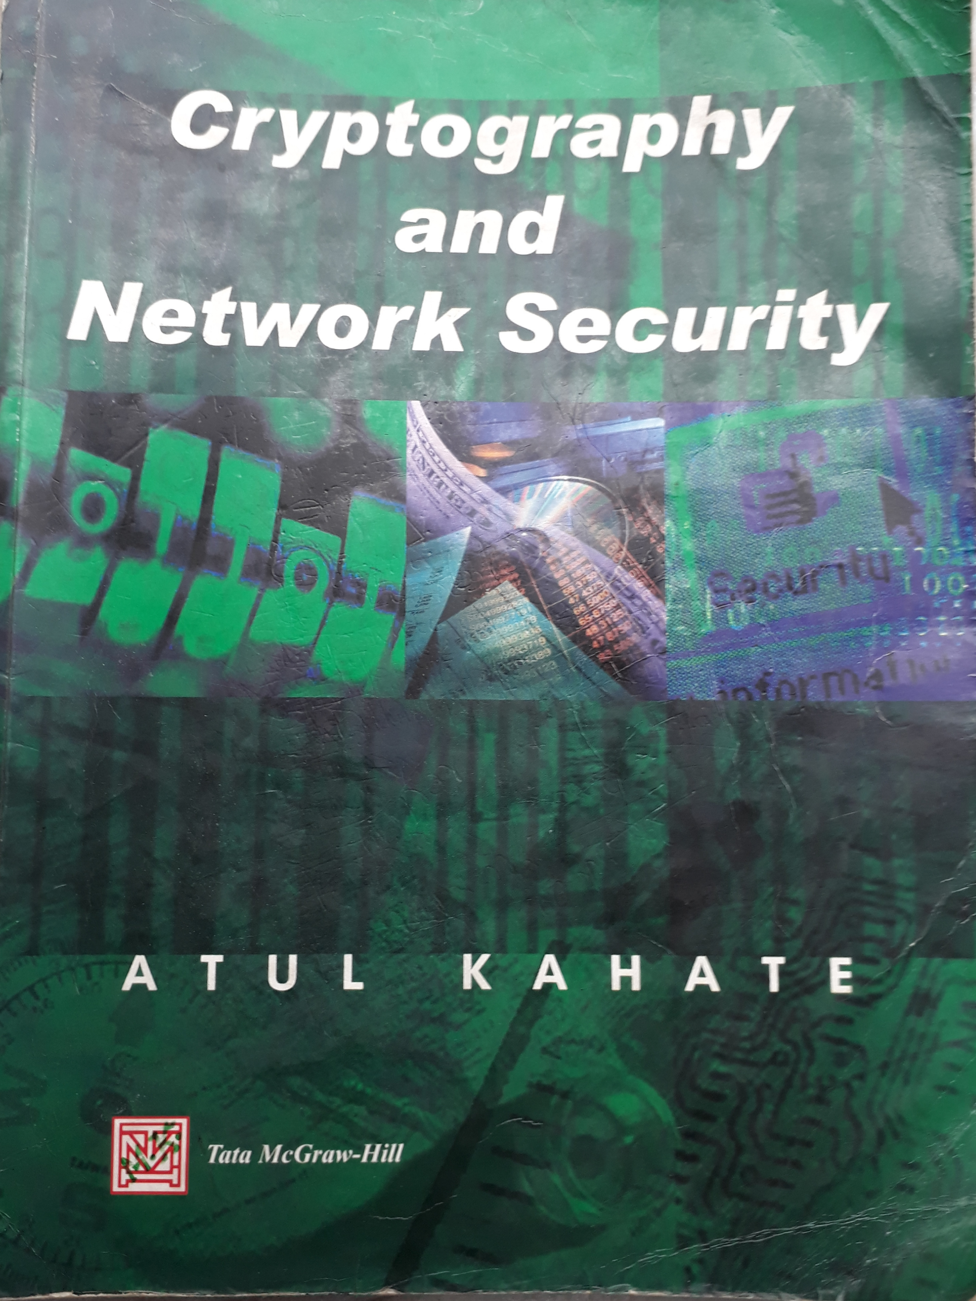
Books (1/2)

Slide 2
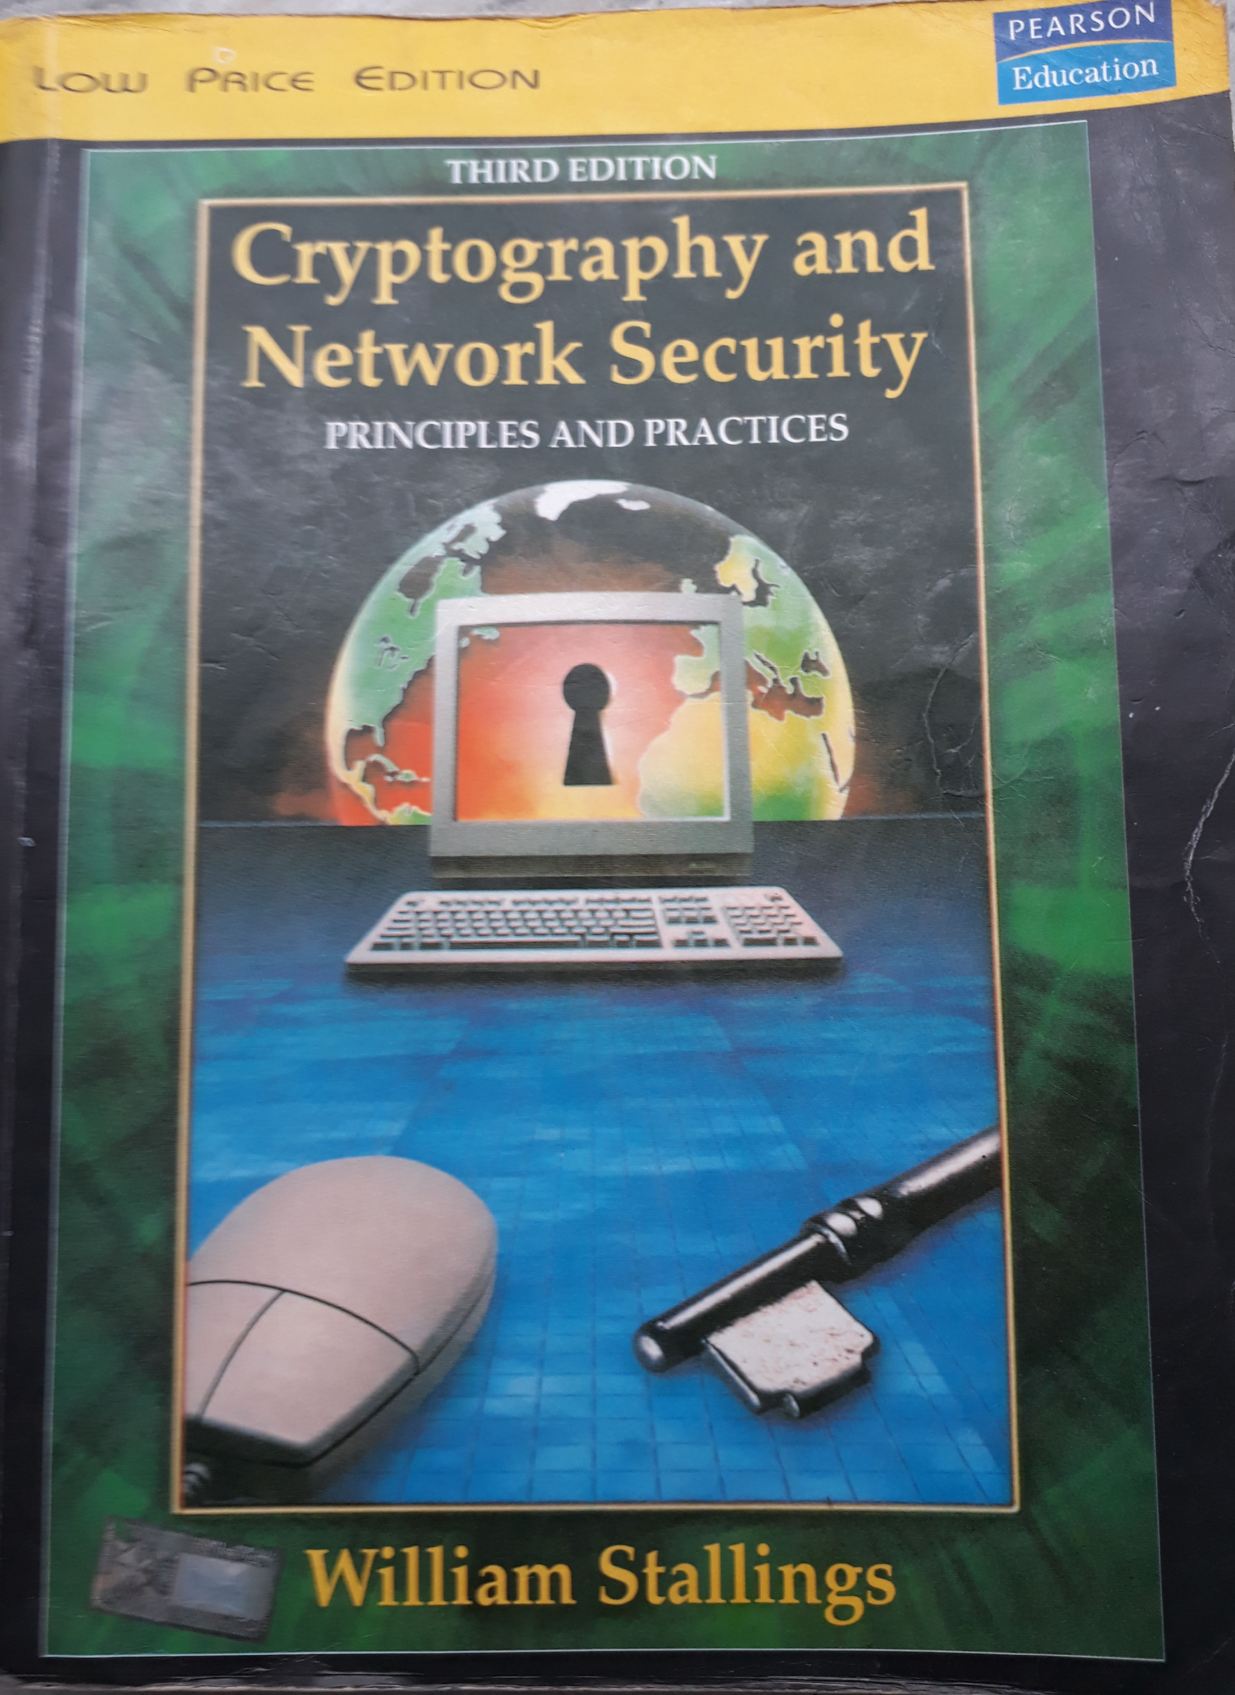
Books (2/2)

Slide 3
Information Security
“Three people can keep a secret only if two of them are dead”
----- Benjamin Franklin

Slide 4
Security Models
No security
Security through obscurity
Host security
Network security

Slide 5
Principles of Security
Confidentiality
Authentication
Integrity
Non-repudiation
Access control
Availability

Slide 6
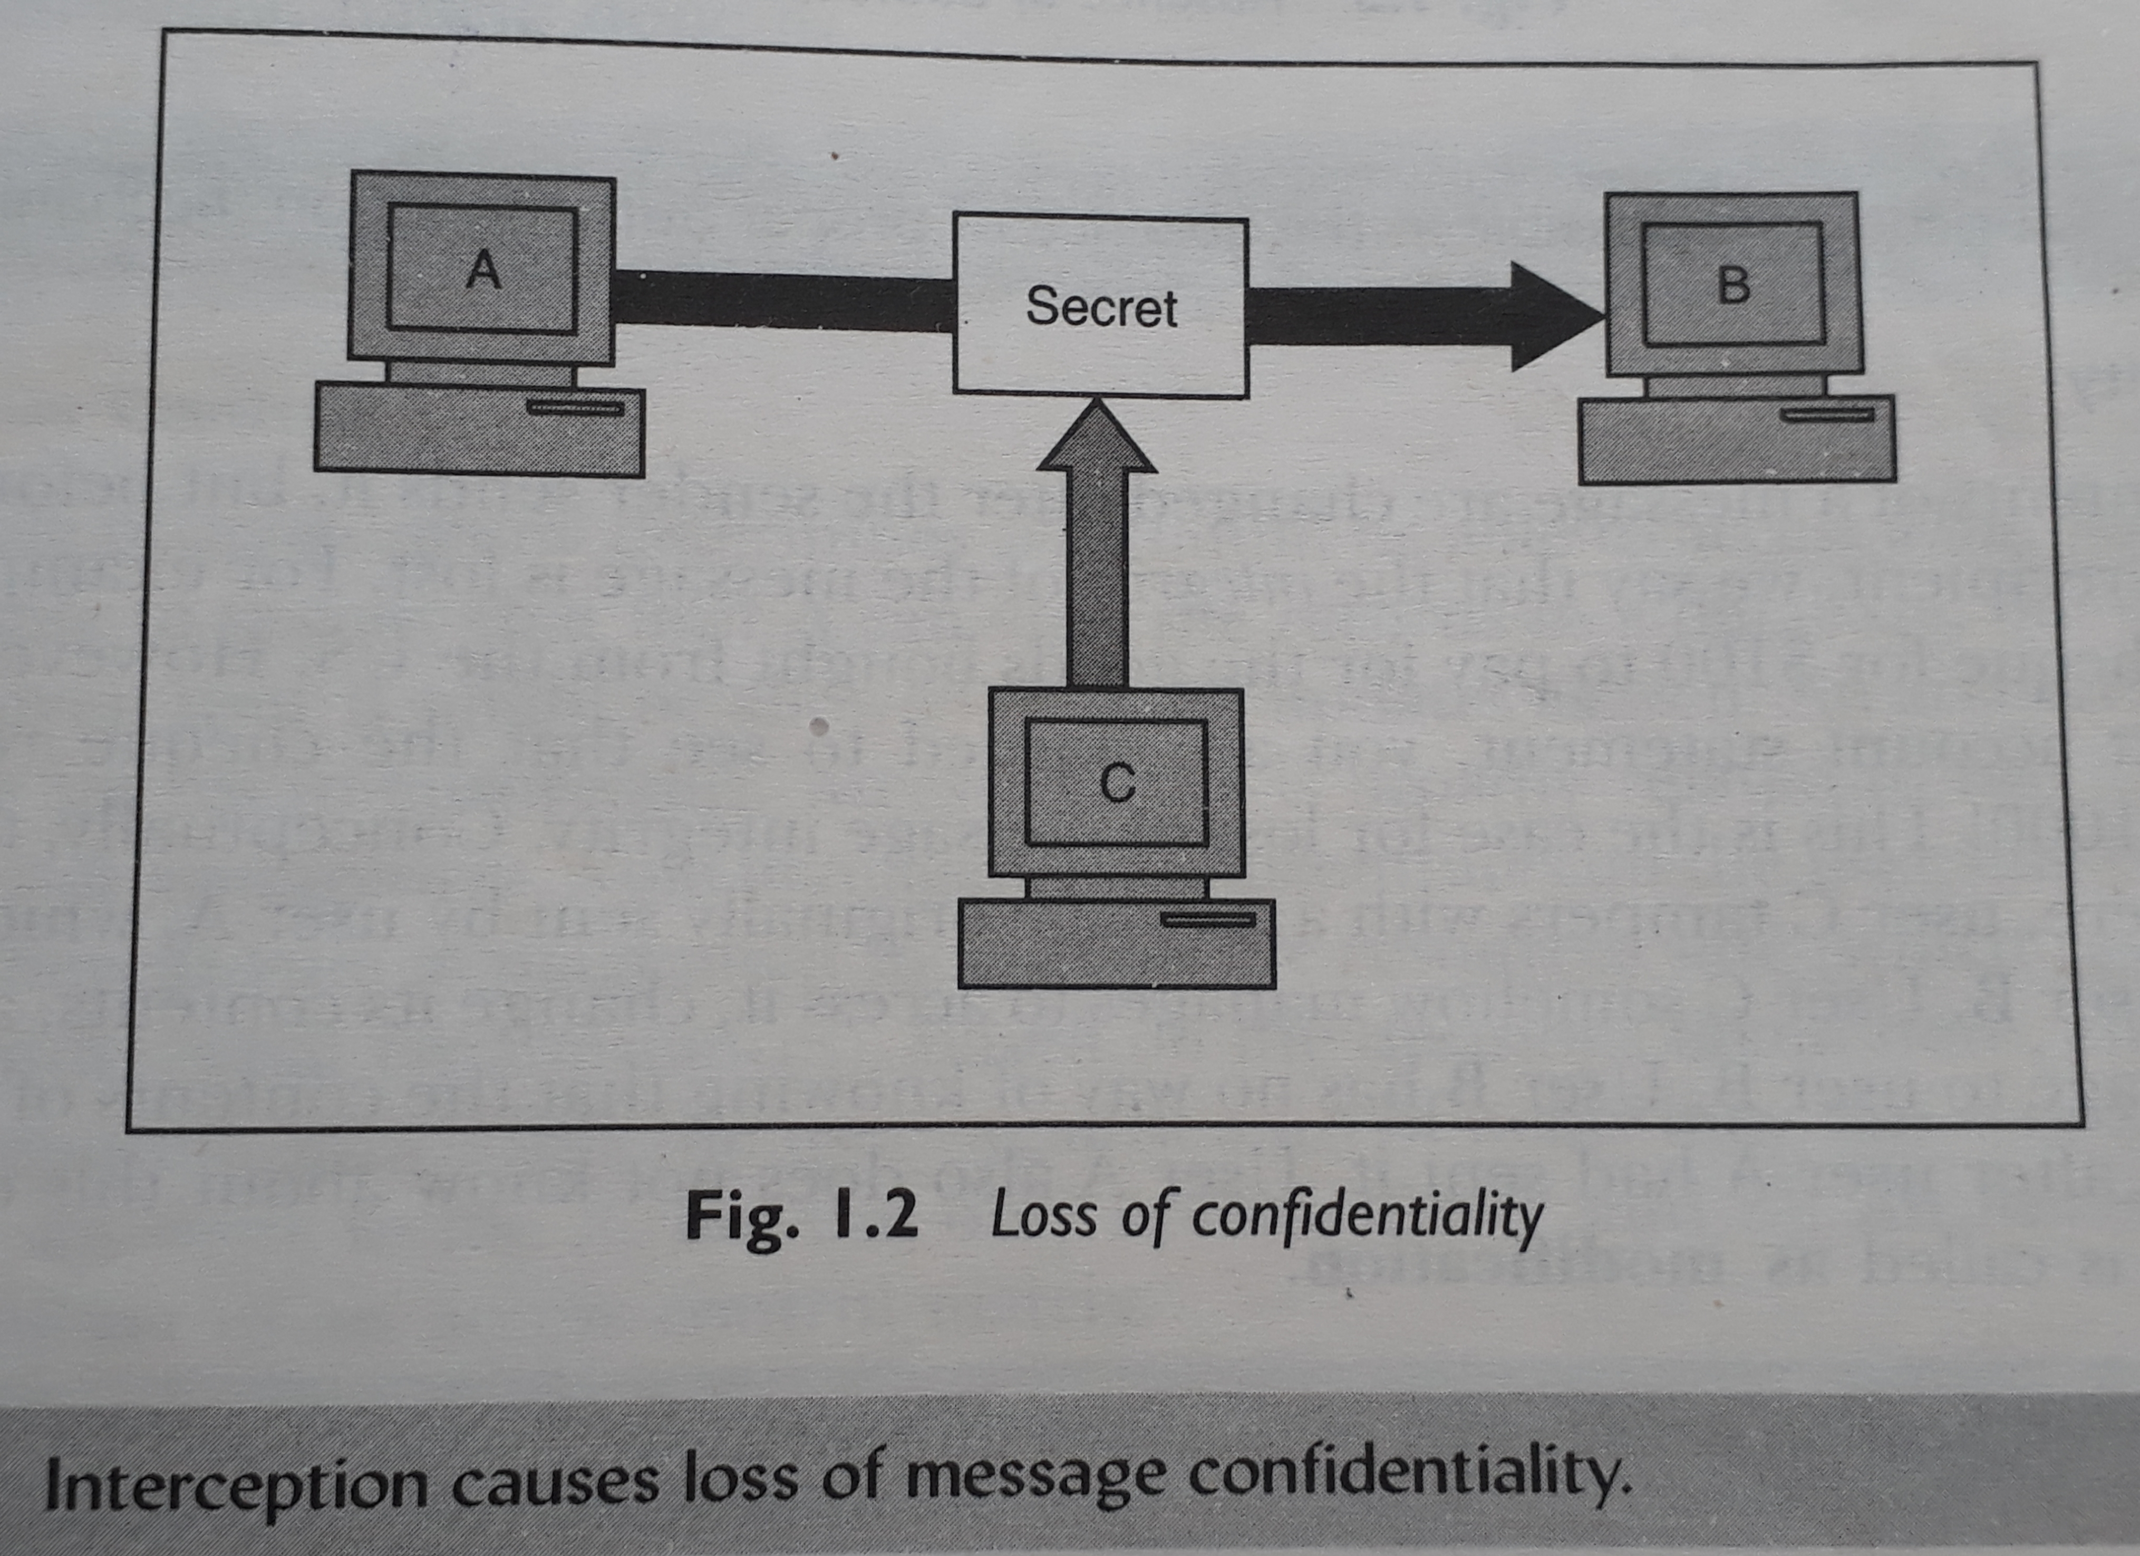
Confidentiality
1 :

Slide 7
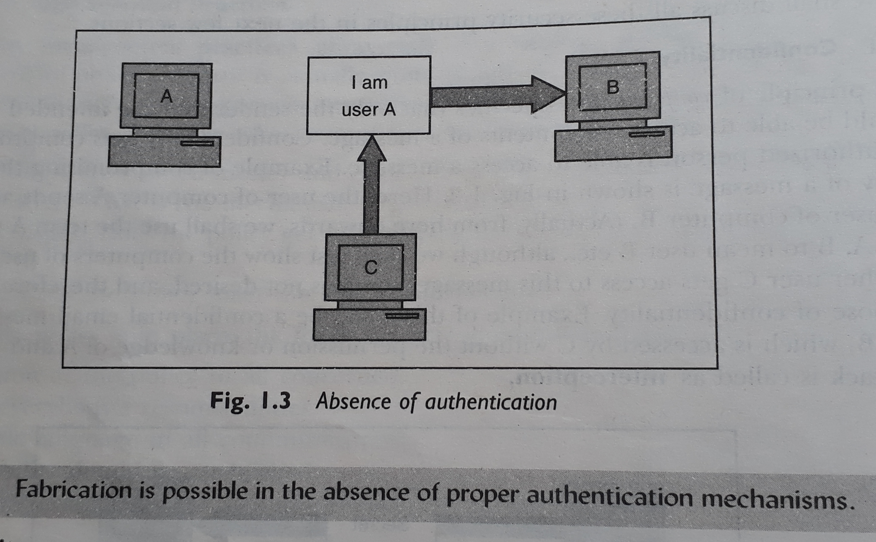
Authentication
2 :

Slide 8
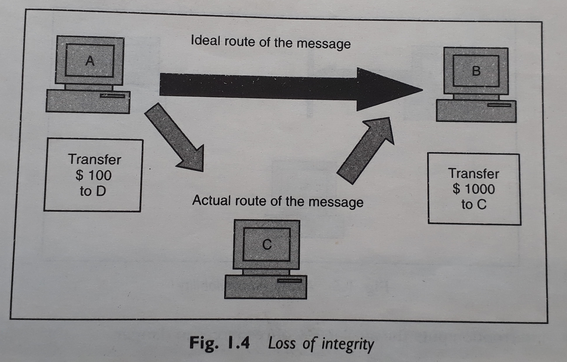
Integrity
3 :

Slide 9
Non-repudiation
Non-repudiation does not allow the sender of a message to refute the claim of not sending that message.
Digital Signature can be used to maintain this principle of security.

Slide 10
Access Control
Access control specifies and controls who can access what.
Access control is broadly related to two areas:
a) Role Management – which user can do what.
b) Rule Management – which resource is accessible and under what circumstances.

Slide 11
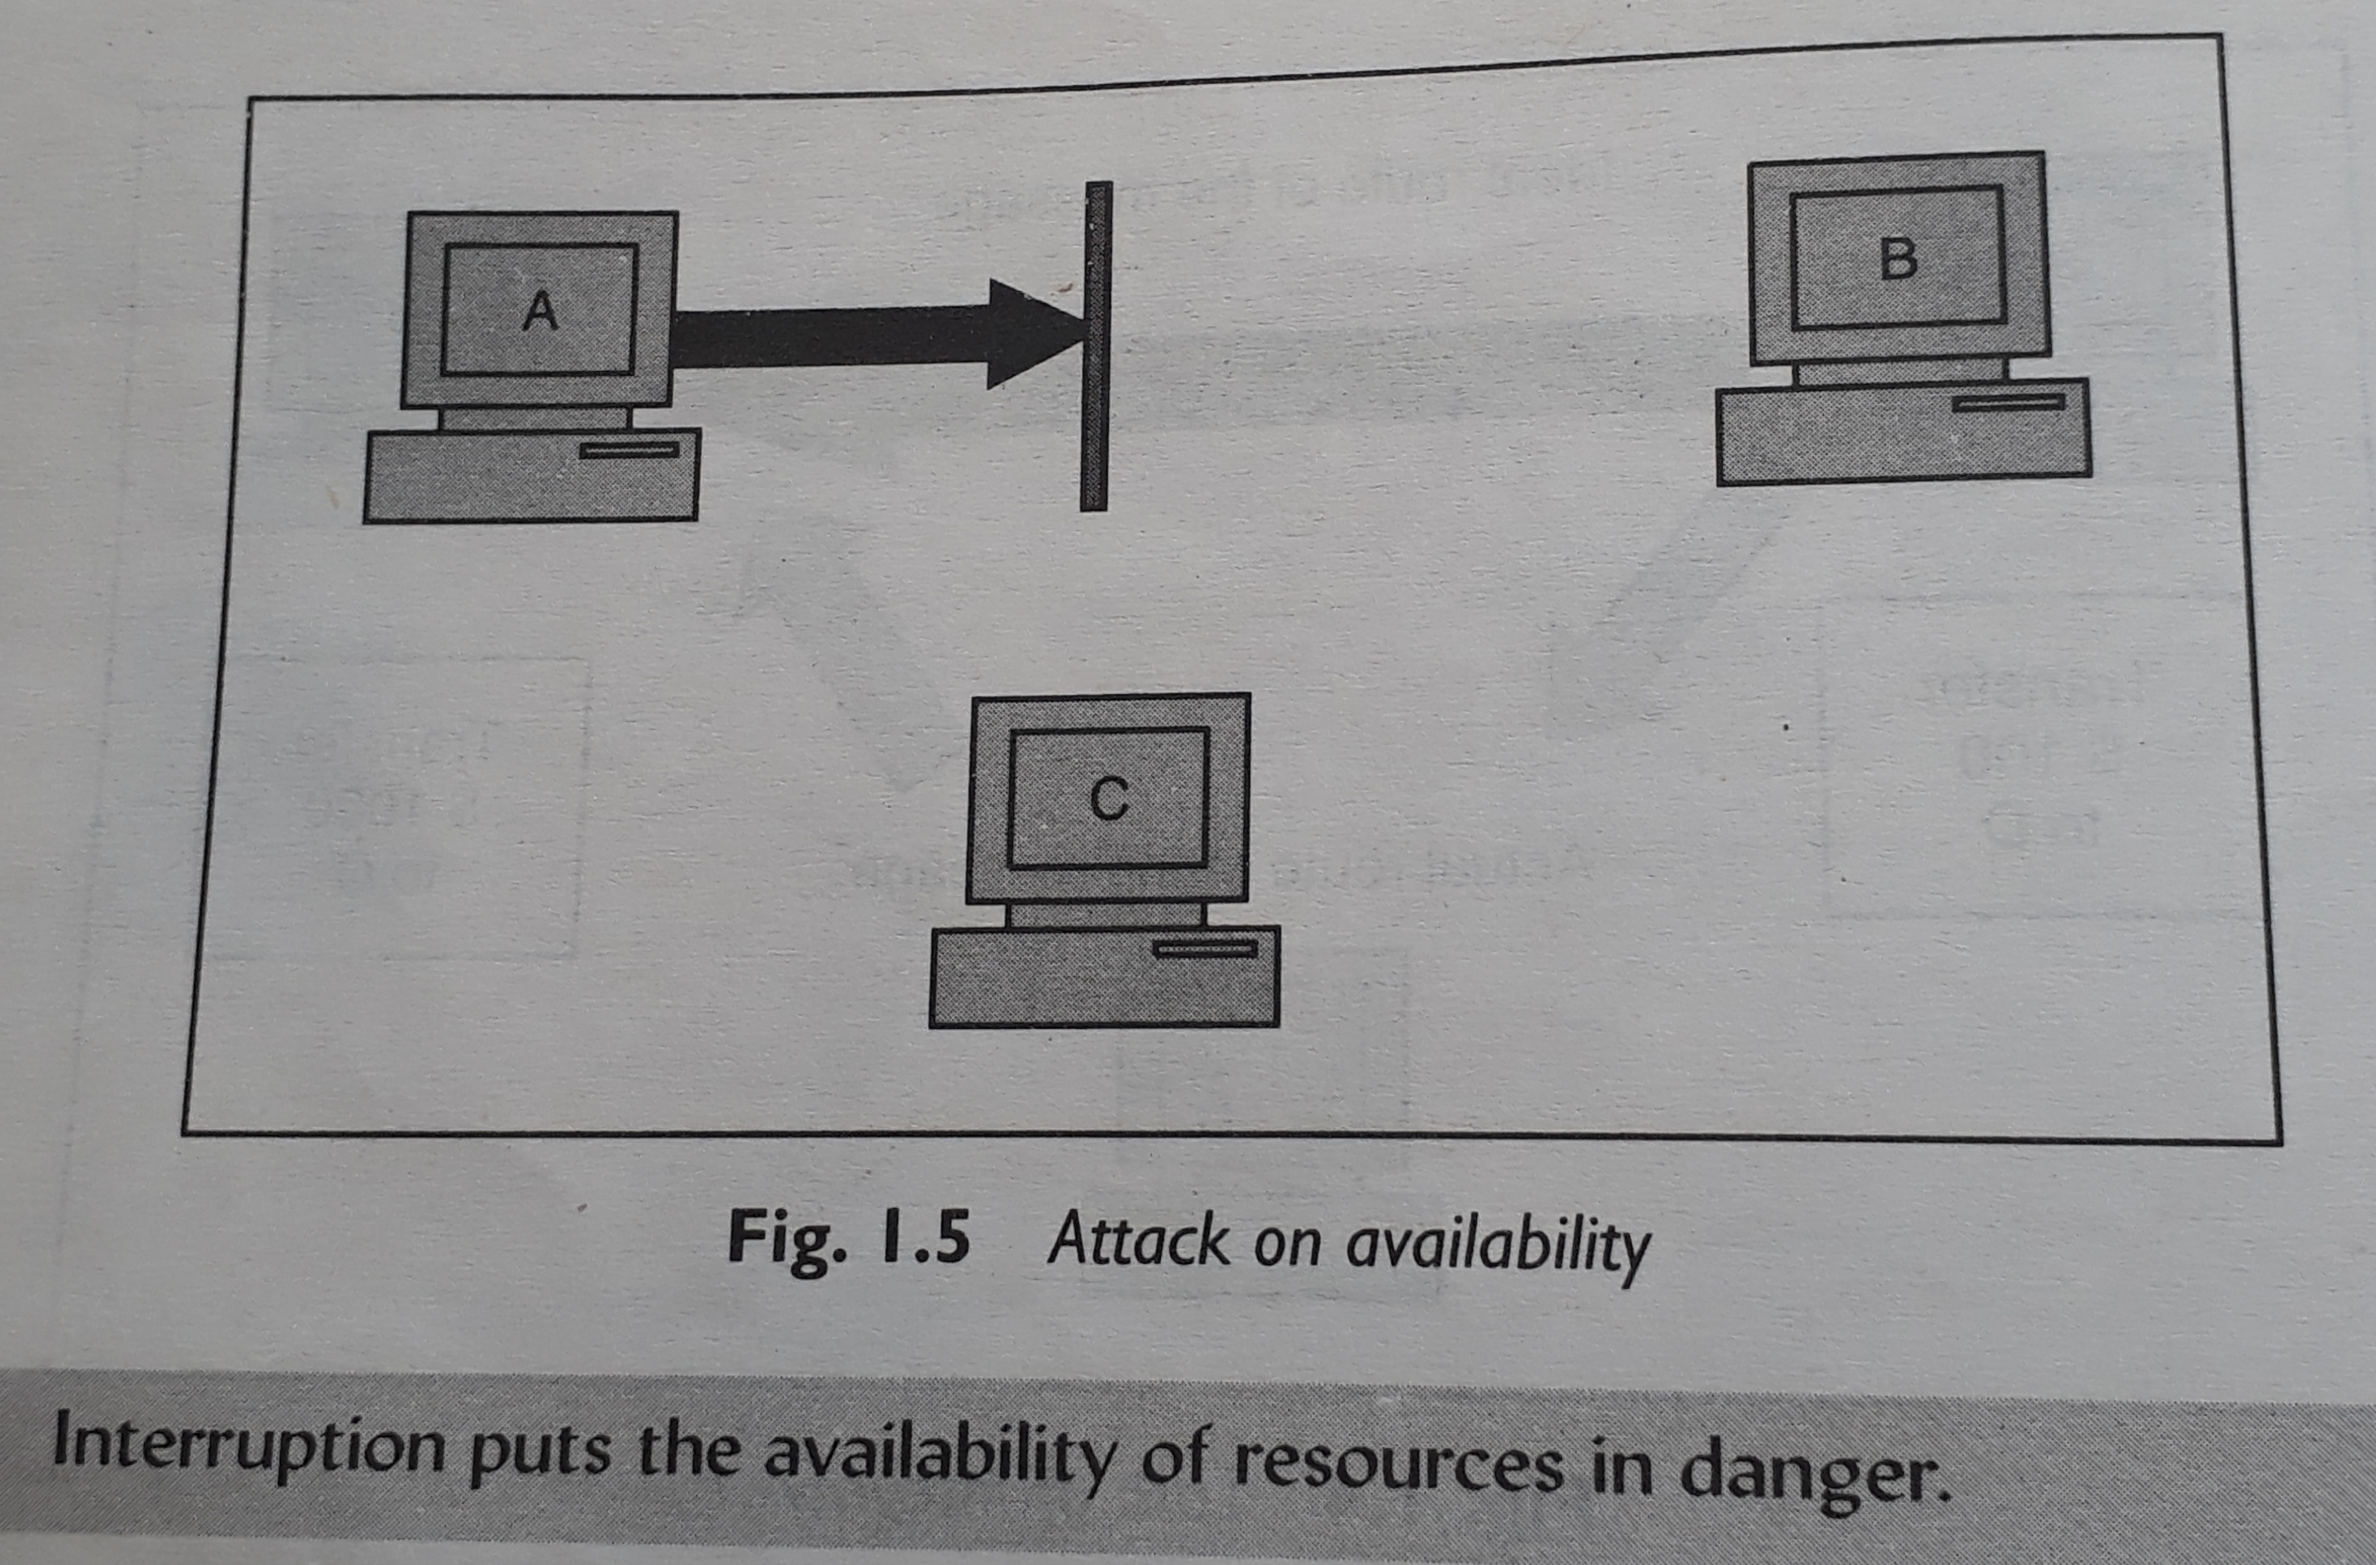
Availability
4 :

Slide 12
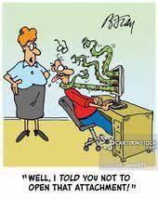



What are these?

Slide 13
Threat
A threat is a potential violation of security.
The fact that the violation might occur means that those actions that could cause it to occur must be guarded against. Those actions are called attacks.
Those who execute such actions, or cause them to be executed, are called attackers.

Slide 14
Types of Attack
Broad Categories
Theoretical concepts behind the attacks
Practical approaches used by the attackers

Slide 15
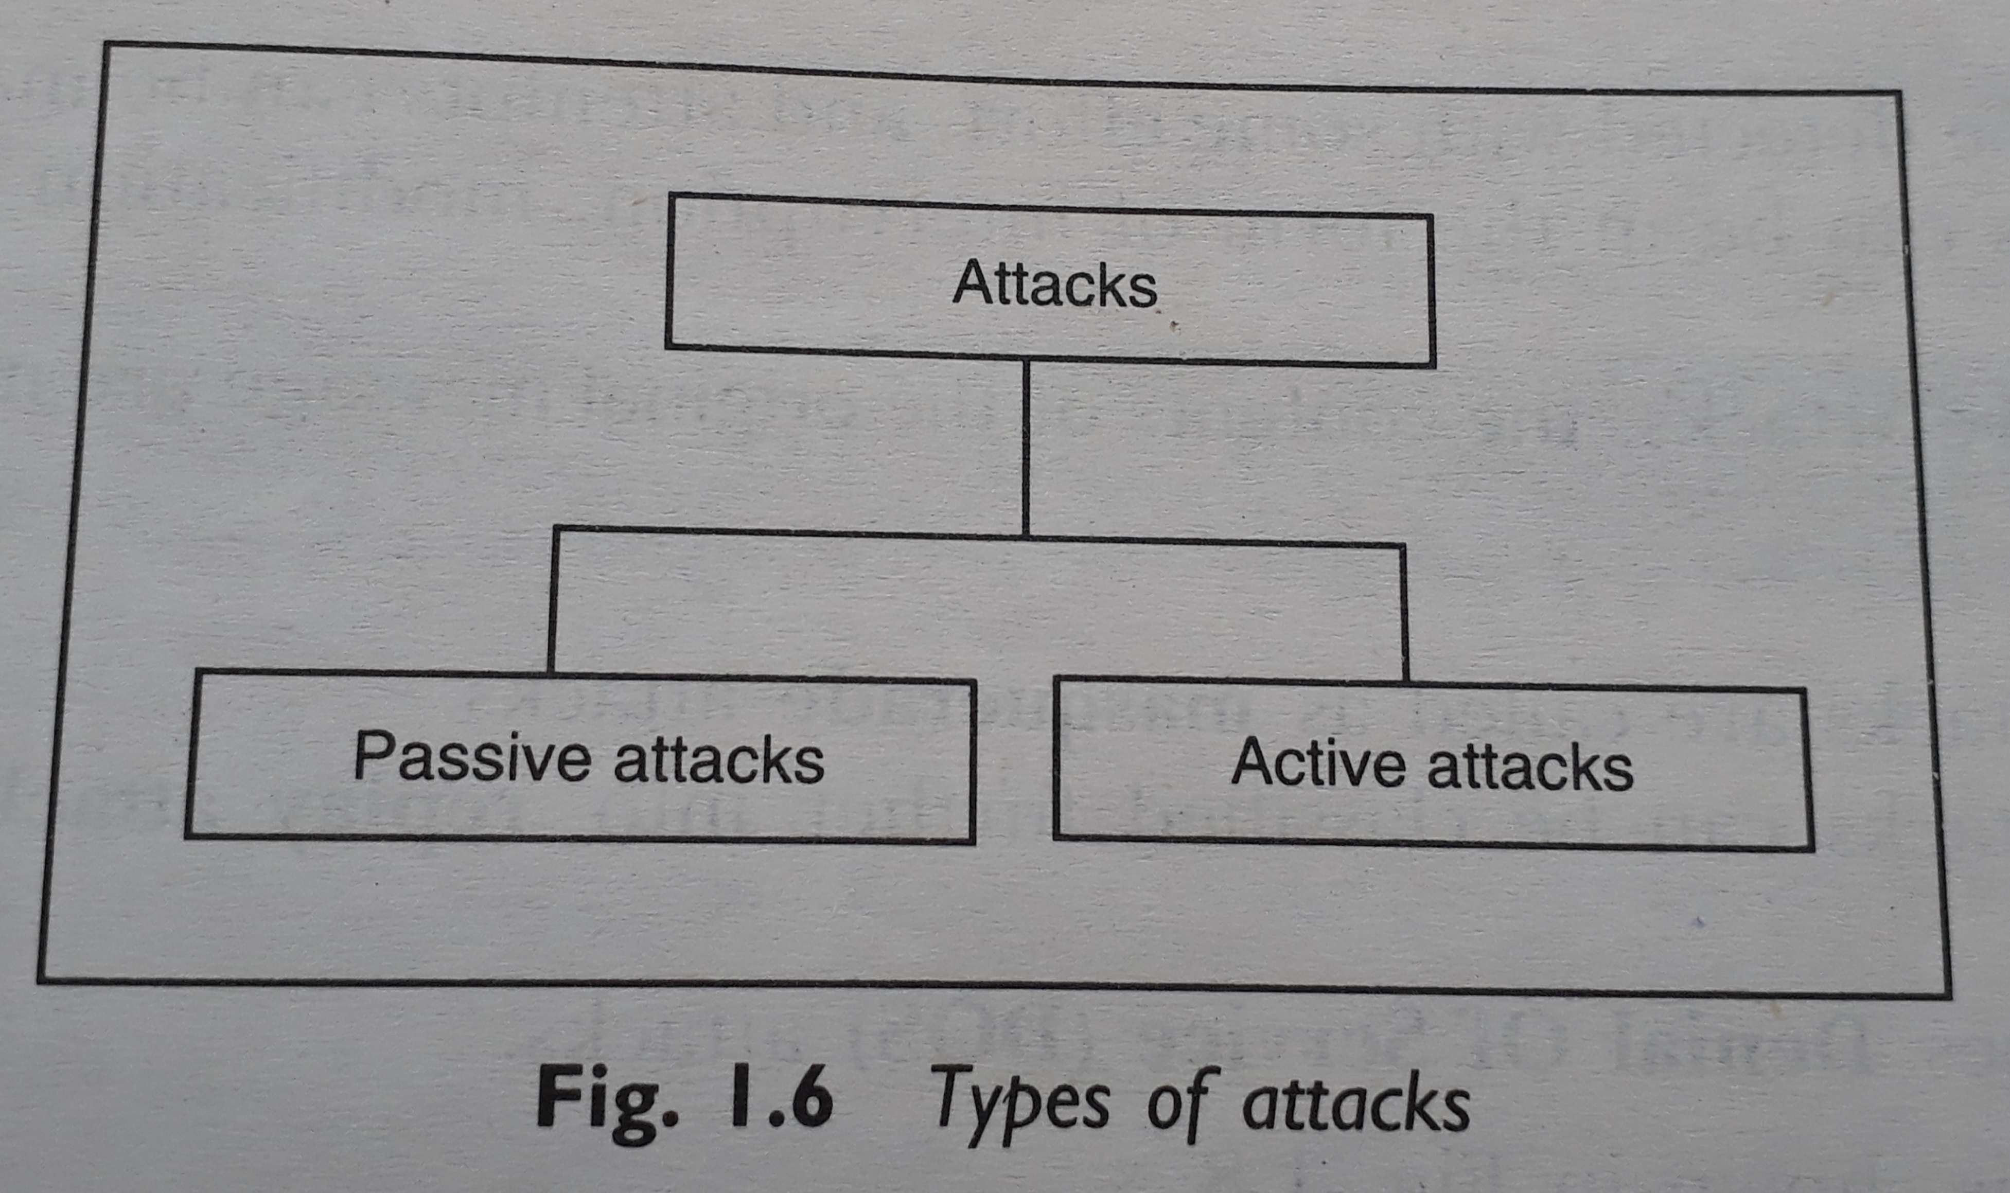
Theoretical Concepts
5 :

Slide 16
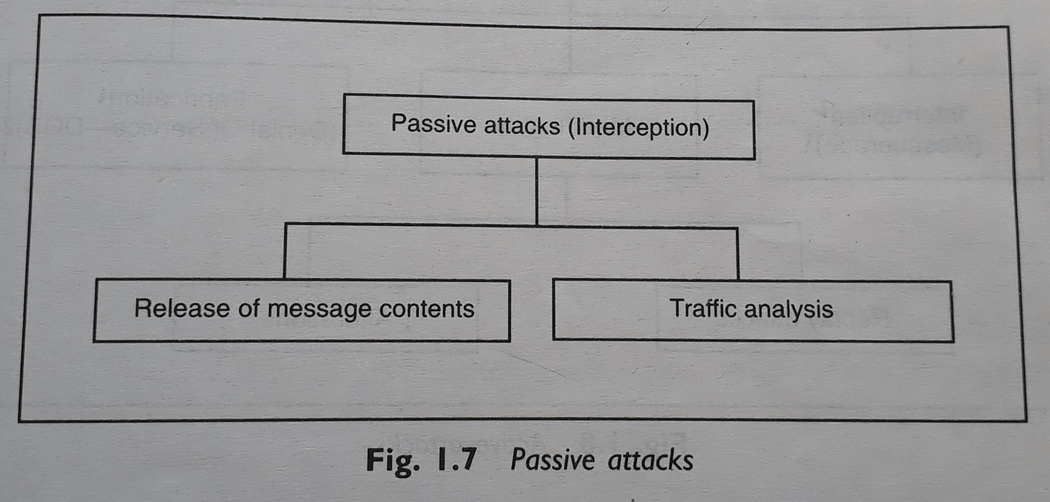
Passive Attacks
6 :

Slide 17
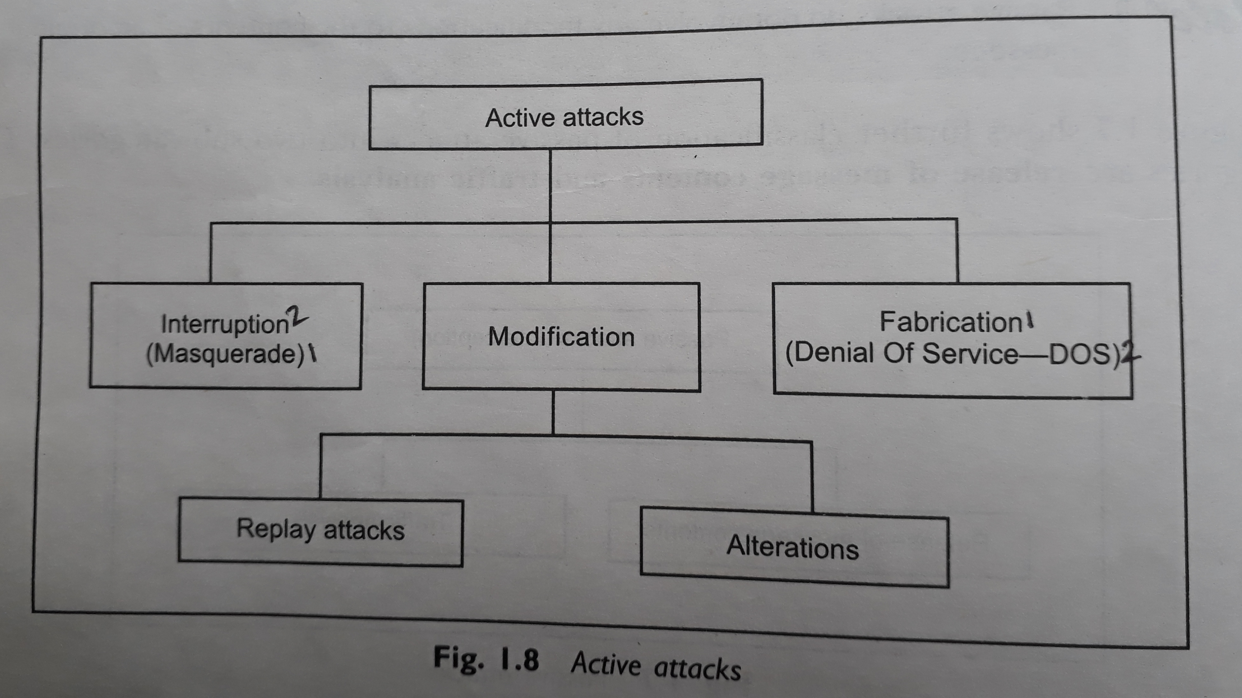
Active Attacks
7 :

Slide 18
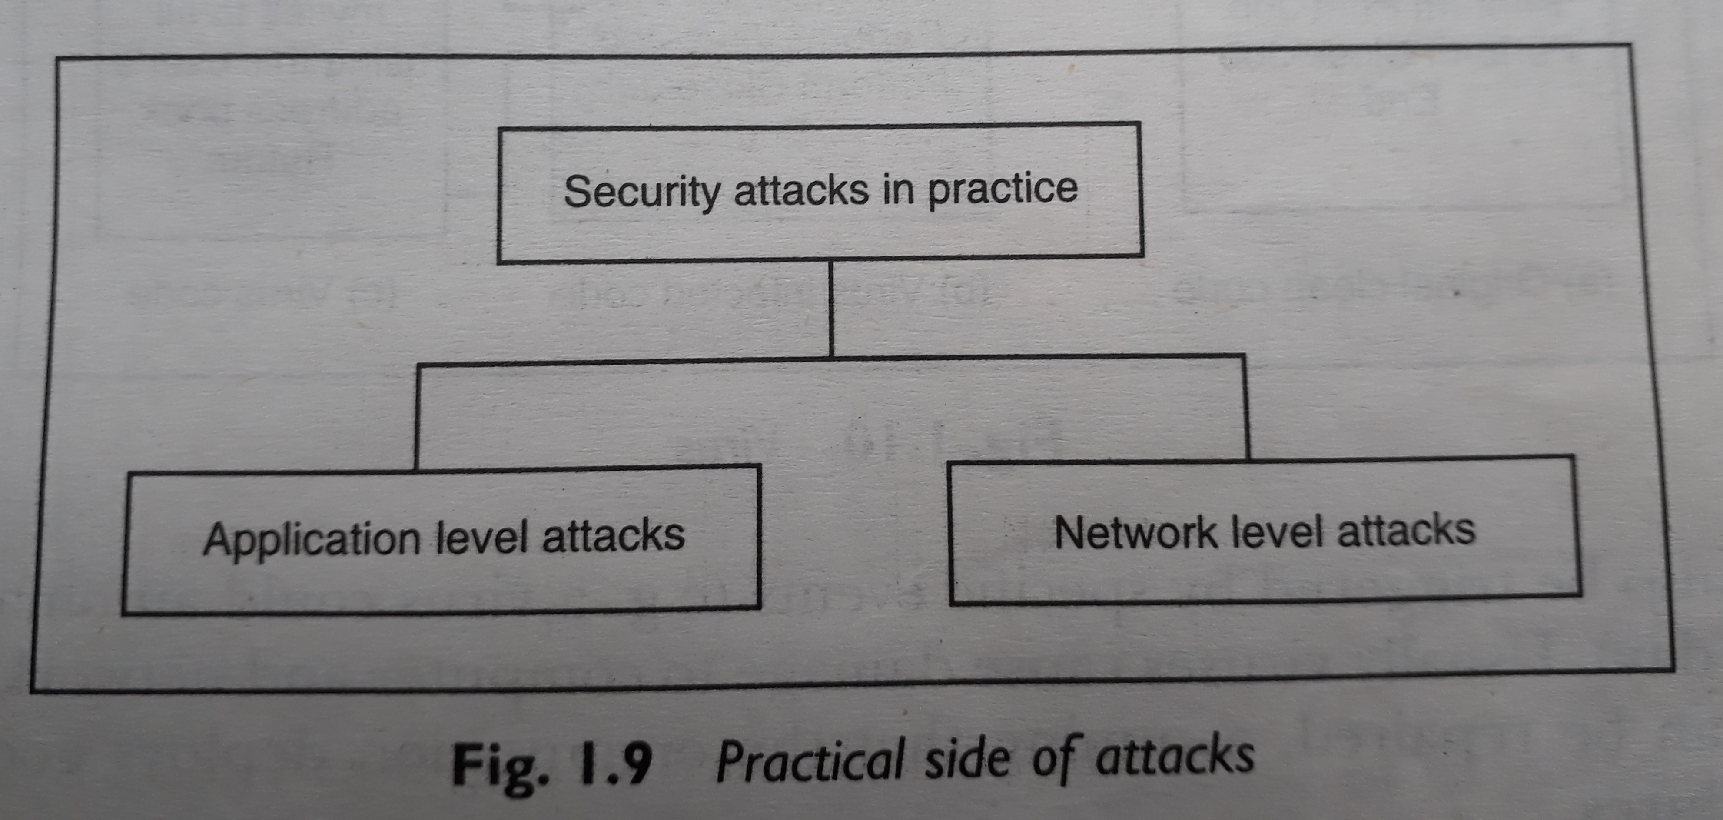
The Practical Side of Attacks
8 :

Slide 19
Specific Attacks
Packet Sniffing (Snooping) / IP Sniffing
Packet Spoofing / IP Spoofing

Slide 20
Thank You

Slide 21
Questions?

